Slide 1
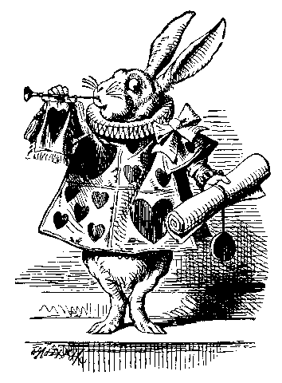
Why put a library in
everybody's pocket?
Greg Newby
  Director, Arctic Region Supercomputing
  Center, University of Alaska Fairbanks
  Director and CEO, Project Gutenberg
  (volunteer)
Notes:
This presentation, including all words and images, is granted to the public domain. To my knowledge, all the images are in the public domain in the US. Most came from Project Gutenberg. Authored by Greg Newby for a presentation at the Wolfram Data Summit. September 5-6 at the Washington D=C Park Hyatt.
Presenter: Dr. Gregory Newby
Affiliation 1: Director, Arctic Region Supercomputing Center, University of Alaska Fairbanks
Affiliation 2: Director and CEO, Project Gutenberg Literary Archive Foundation
Title: Why put a library in everybody's pocket?
Brief abstract (70 words):
What might it mean for everyone to have his or her own digital library, with full access and control? A library that could be shared, in parts or in whole. Where each item is fully unlocked: print, save, edit, mark up, and extract portions. We will discuss Project Gutenberg's approach to providing a personal library, and how Summit attendees could apply this principal to their own digital collections.
Narrative abstract:
What might it mean for everyone to have his or her own digital library, with full access and control? A library that could be shared, in parts or in whole. Where each item is fully unlocked: print, save, edit, mark up, and extract portions.
For most of the history of eBooks, emphasis by key producers and distributors has been on insuring that individuals and organizations get complete and perpetual access to eBooks. For example, this is the mission of Project Gutenberg, and it's a major emphasis for The Internet Archive. In the past eight or so years, however, emphasis has shifted. The first Kindle (2007) came on the heels of the launch of Google Books (2004 launch, availability a little later). Those and other technologies, especially today's cloud-based storage, storefronts and services, tend to keep an individual's library on remote systems, placing a temporary copy on the device a person uses, and without complete and perpetual access to the eBooks.
Thanks to the proliferation of cell phones and other mobile devices, it's a small matter to devote space to a personal library. This library would be available without access fees or delay, could be backed up remotely along with the rest of the device's content, and would work in areas with limited network or cellular bandwidth (or high access fees).
We will describe Project Gutenberg's efforts to let anyone build their own personal library, using the Project Gutenberg corpus. The process of selecting titles, formats and other details from millions of files is non-trivial, but satisfying. Individuals can create libraries of just a few items, or many thousands.
Attendees will be asked to consider the power of a personal, portable, highly usable copy of a subset of relevant content from their collections. This isn't intended as a replacement for cloud- and network-based access to materials, but rather a relatively small personal collection of the most pertinent items for regular use. This personal slice of a larger dataset will give end users a reason to return to the larger site, for more or updated materials. When combined with applications that could be run locally, against the personal extract, end users will be able to engage in personalized and ongoing uses. This approach can lessen the need to visit and navigate through a collection's main interface. Locally-run applications could make it easy to combine the personal library with the remote master collection, for a variety of add-on features and for further reading.

Slide 2
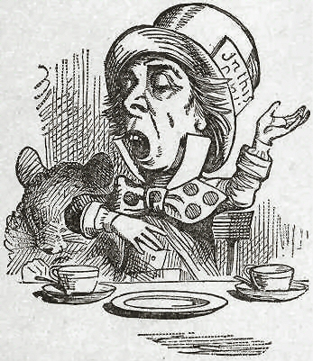
Outline of today’s discussion
Get acquainted
Dream: What could be
Think: What we are doing today
Plan: How what we do tomorrow can help bring about our dreams
Notes:
Here’s what we’ll be talking about today?

Slide 3
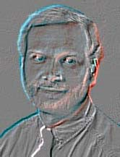
Your humble narrator
Information scientist, with broad interests
Involved with Project Gutenberg since 1991
Working today in a variety of contexts to connect people to information
More: www.petascale.org
Notes:
I’ve been working for decades to make information resources more available and usable to people.

Slide 4
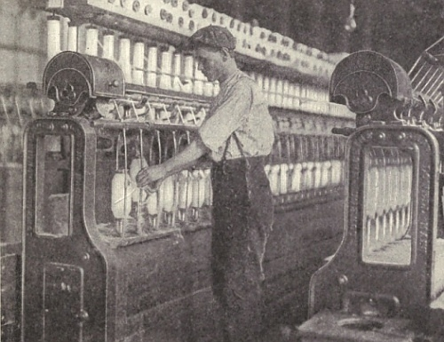
Let’s dream together
Technology augments human capabilities
Notes:
Here’s a cotton roving machine, one of many technologies that enable modern society

Slide 5
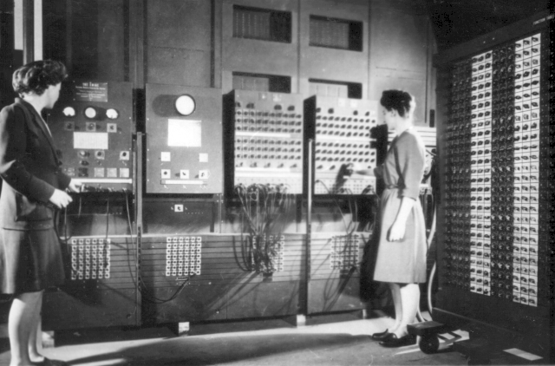
Information technology augments human knowledge, intellect, analytical skill
Notes:
This early computer certainly didn’t fit in anyone’s pocket. But even at the time, 50 or more years ago, people were talking about how machines would augment human intellect.

Slide 6
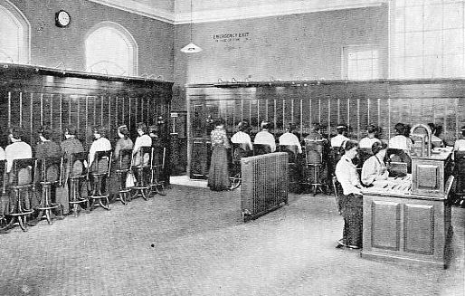
Information technology also makes it possible to engage more directly with other people, and with information systems: transcending the individual
Notes:
An early telephone exchange. Can you remember your first telephone call? Probably not… Today, what happens when you are suddenly unable to communicate with anyone, anywhere, at any time? Angst!

Slide 7
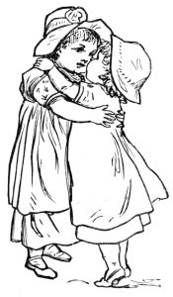
Where can information technology eventually take us?
For individuals: Unbounded intellect, unlimited access to information and analytic capabilities
For society: Peace and understanding, as a result of effective shared meaning
Or… your own goals
Notes:
There are lots of potential futures that emerge from next phases in information and communication technology. It is my view that these all require immediate and flexible access to information, in order that our own intellects may be extended. In 1975, Bertram Brookes called the holding of information outside of our own minds “exosomatic memory.” Today, people use technologies like mobile phones, browser bookmarks and search engines as exosomatic memories.

Slide 8
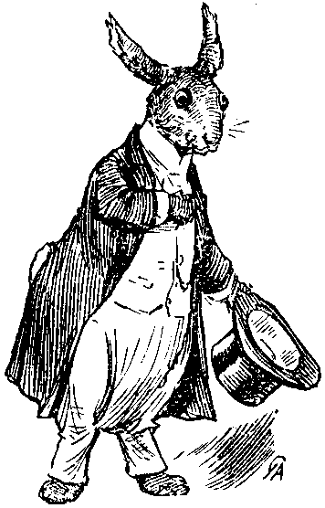
Let’s think together
How might a personal library help achieve our goals?
Notes:
And now, I will pull an entire library out of a hat! (Do it: opera hat with a USB drive or microchip)

Slide 9
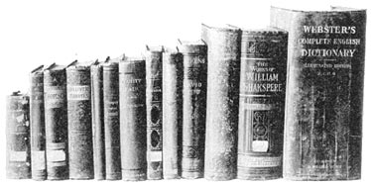
Notes:
We’re talking about this, but digital

Slide 10
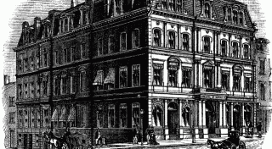
Notes:
Not in one of these…

Slide 11
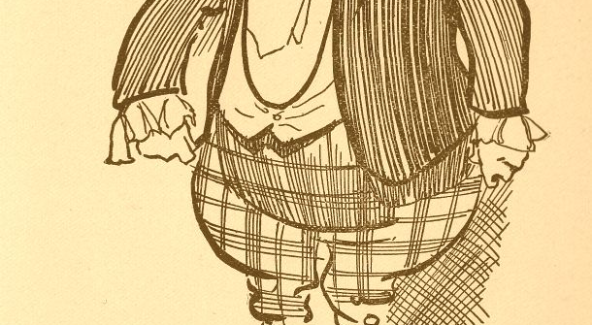
Notes:
But one of these. Or on a mobile phone, or a wristwatch.

Slide 12
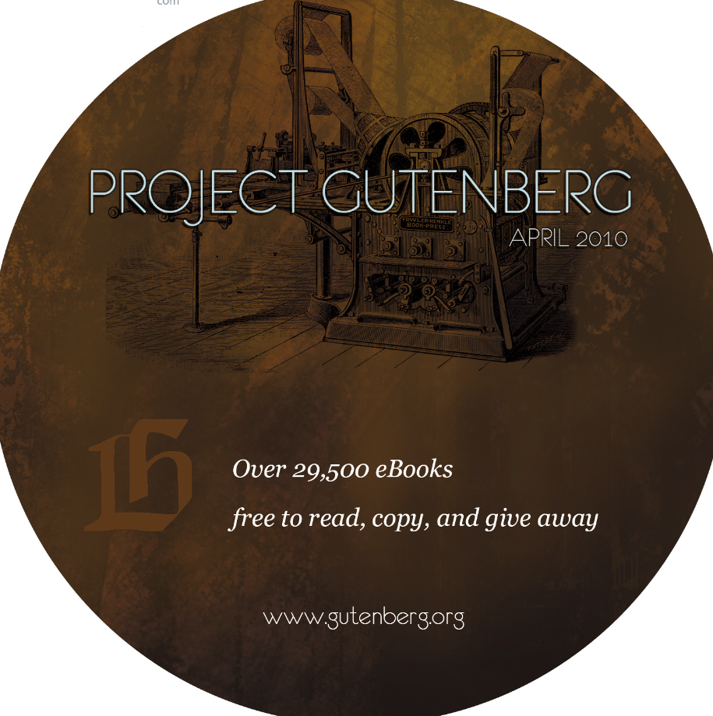
Notes:
Here’s one you can take home with you. Almost 30,000 books on a dual-layer DVD. Or, download the ISO from www.gutenberg.org/cdproject. Help yourself, they’re in the back of the room.

Slide 13
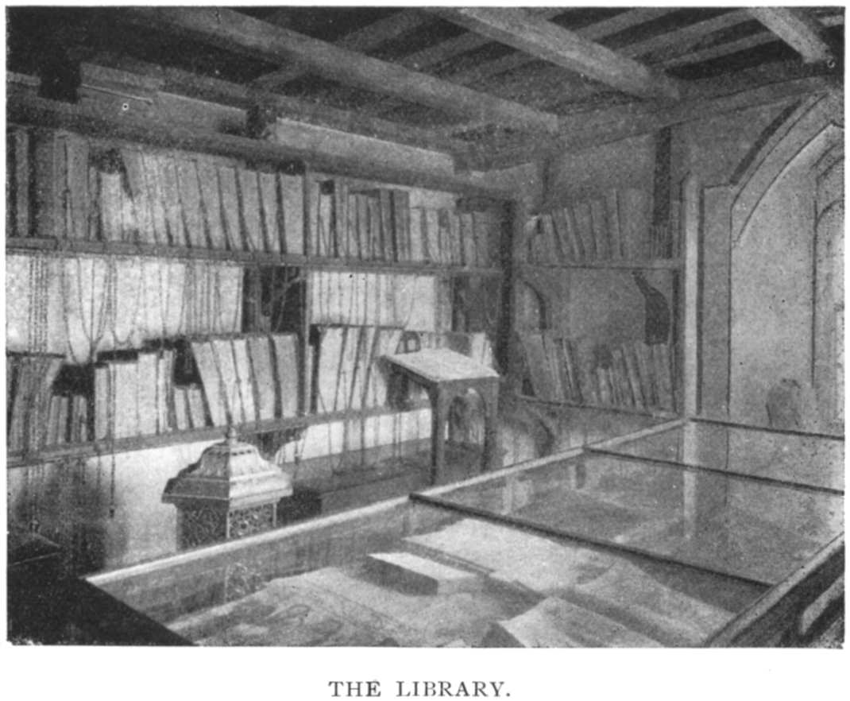
What I just did is a major shift in information empowerment, as important as the first moveable type printing press
Books used to be chained… people couldn’t afford them, and literacy was rare
Notes:
Lots of books were in Latin, too. See the chains, in this image from an 1899 publication in England: chained libraries held on a long time!

Slide 14
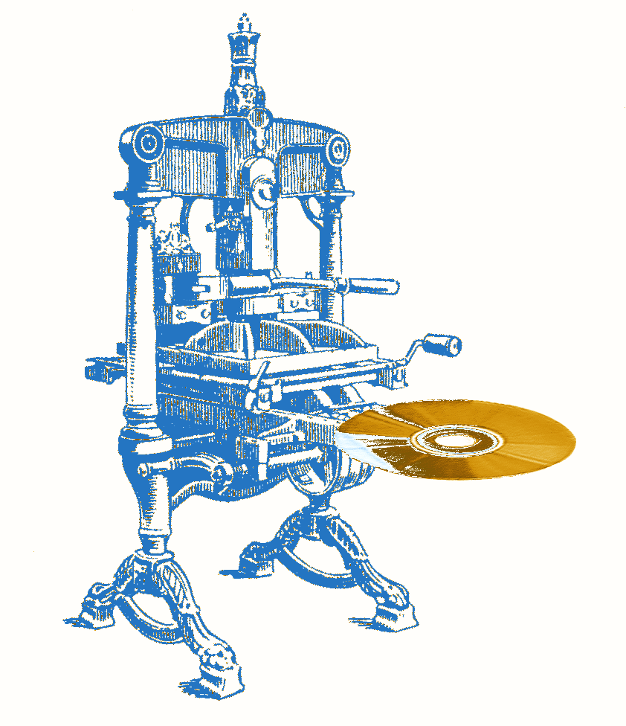
From printing press … to digital press
First eBooks: 1971
Google Books: 2005
Kindle: 2007
iPhone: 2007
Today, there are over 6 billion mobile phone subscribers. Can we get them each a library?
Notes:
We are less than a decade into a major revolution in how people interact with their information. The do it personally!

Slide 15

Yes, we can
Project Gutenberg wants everyone to have his or her own book, and to make a collection in his or her own library
www.gutenberg.org/cdproject: ISO maker for larger collections
www.gutenberg.org/wiki/Category:Bookshelf: subject collections
Auto-conversion to EPUB and MOBI and other formats, not just text and HTML. All books, in all major formats, for any device.
Save … print … extract … convert … delete … expunge …
reformat … mash up …
Help create the next new book! www.pgdp.net
Notes:
Using the ISO maker or bookshelves or other mechanisms, you can make sure you get the latest version of a book, in case it’s been improved since you last checked.

Slide 16
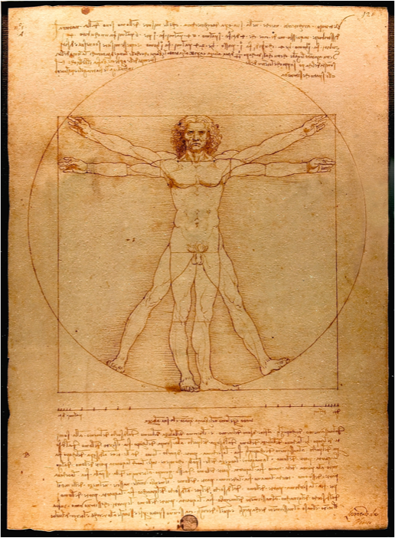
Let’s plan
With Project Gutenberg as an example, what other data content could be in someone’s digital pocket?
What trends are counter to this desire?
Notes:
We’ve done dreaming and thinking. Together, let’s plan how the types of activities represented by the people at this Data Summit can achieve our dreams.

Slide 17
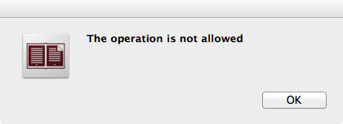
Impediments to other personal libraries
Locality of information source (can we access, and re-access, directly?). Good: download a sea ice map from NSIDC; less good: Flash-based infographic on cnn.com
Utility of information source (can we easily manipulate it, or are we limited by external constraints?). Good: raw data, editable images. Less good: uneditable formats or restricted utility
Notes:
Error message from trying to print to PDF from within a Digital Editions manual on Digital Editions (huh?)

Slide 18
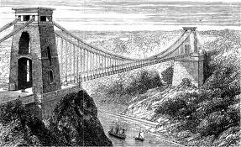
Tyranny of the Interface
Interface: what is between us and the information we need? Do we need to re-navigate the interface on every visit? Login? Understand some sort of API or other programmatic interface?
Notes:
The interface is BETWEEN us and where we want to go (Donald Norman said that).

Slide 19
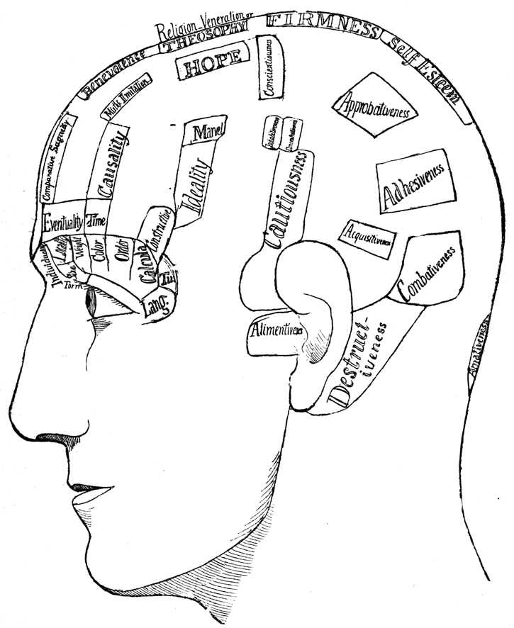
Why locality matters
Latency to access, including possible need to re-navigate an interface
Integration with other external information (i.e., a memory system, which emerges over time and requires ongoing maintenance)
Notes:
You want your library in your pocket, not someone else’s. Or, if not in your pocket, in your brain.

Slide 20
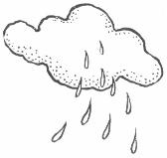
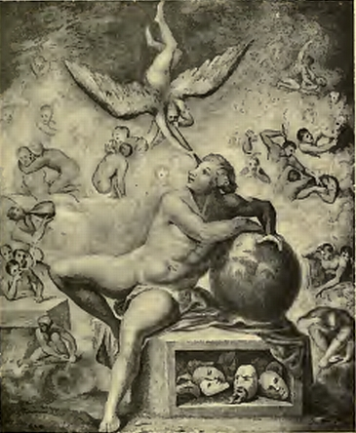
Clouds versus Dreams
If it’s “in the cloud,” it’s not in your pocket. Might be behind an interface, tied to a particular device or program, and with limited functionality.
Haven’t we all lost access to some content, even content we paid for, because something changed over time? Is this the way we want to treat our exosomatic memories?
Notes:
Clouds are great for many purposes, but have a tendency to reduce locality, and limit utility. This is an image from Voltaire’s philosophy on dreaming about humankind.

Slide 21
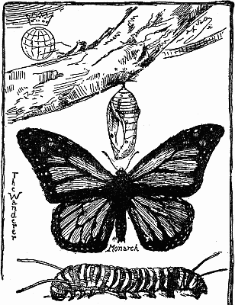
Questions for data providers
Can an information object be manipulated: extracted, reformatted, rearranged, transformed, excised, expurgated, augmented, jazzed or colored?
Can it be joined to other information objects, much as our own memories are engaged in an endless self-creating montage?
Notes:
This isn’t anti-DRM, it’s pro-utilization

Slide 22
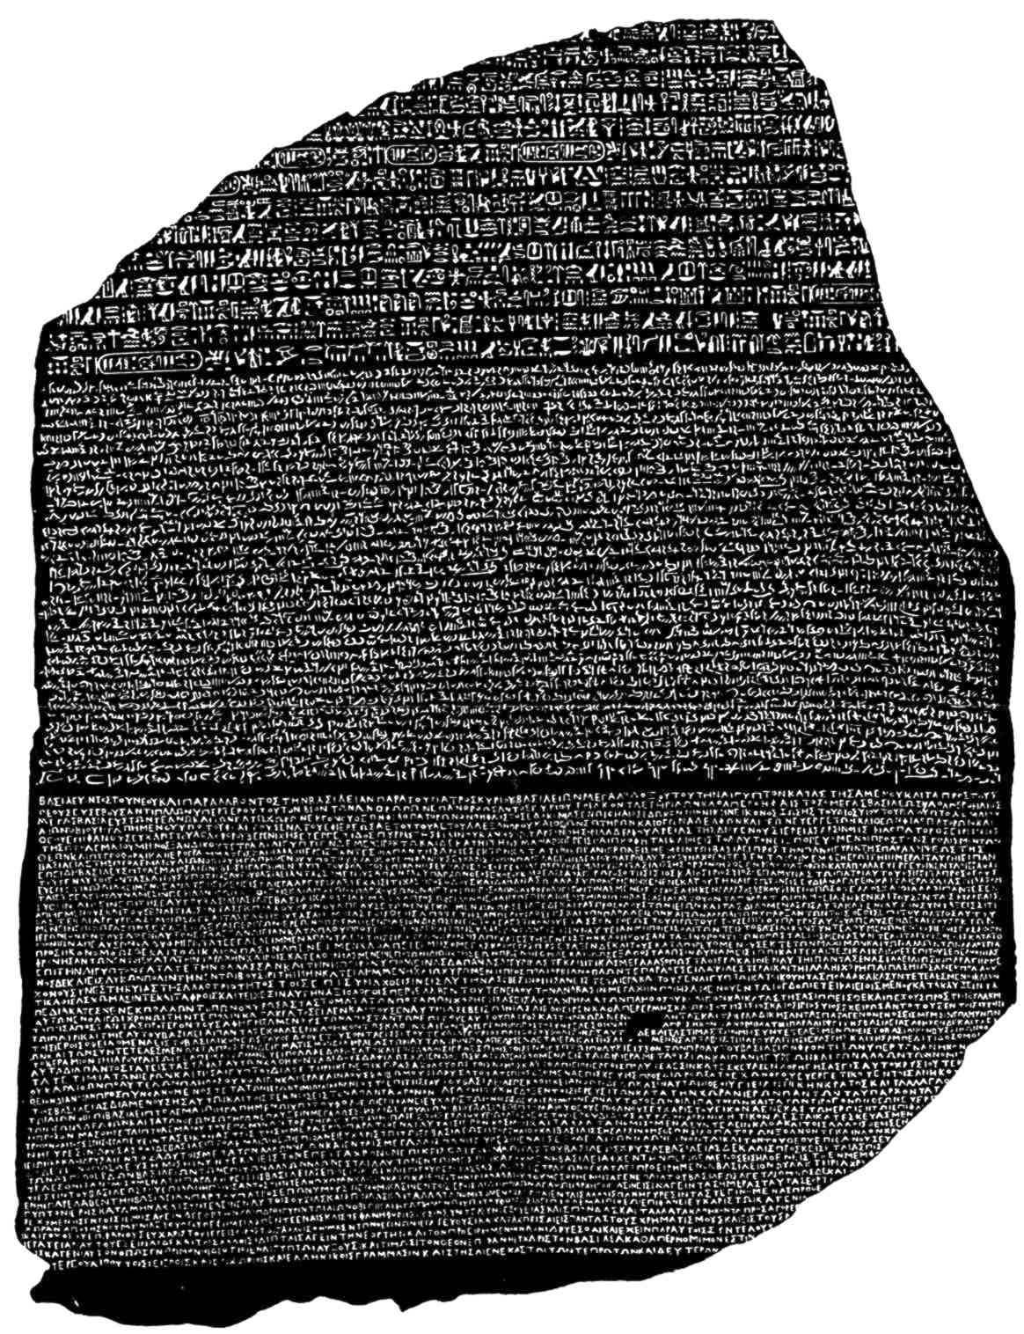
Summing up, from the eBook perspective
What does literacy do for achieving our dreams? How is access to literature (or other content) beneficial?
Augmentation of one’s direct experiences: augmenting knowledge, creating memories, expanding horizons
In electronic form, literature (like other information sources) integrates fairly directly with our psyche
In the long run, literature (like other information sources) will directly tie into our memories and thought processes
Notes:
This is what motivated Project Gutenberg, and keeps us moving towards a goal of digitizing all the world’ literature – one shared (and done well) by Google, Internet Archive, and others.

Slide 23
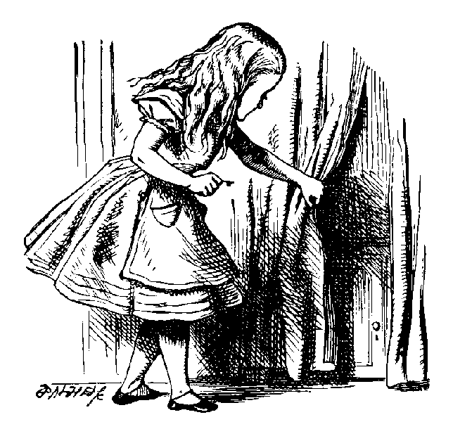
What’s in it for your project? Takeaway thoughts
Are your activities leading extending human intellect and capabilities? If not, why not?
Identify impediments to full utilization, full access, and minimally invasive interfaces. What can you do about minimizing the impediments?
Notes:
Some ideas for your own projects: take a high ground towards ultimate goals. Take a close look at impediments. Consider that a measure of wealth, for individuals and humanity, is our access to information.

Slide 24
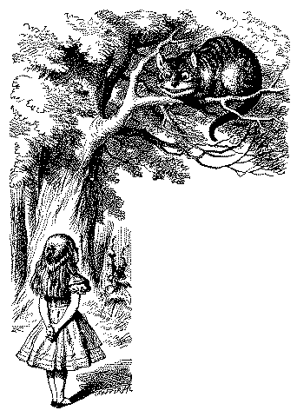
Thanks for listening
Discussion, and Q&A
Notes:
In the long run, I am optimistic that more open and (re-)usable modalities for digital information and communication will come to be the norm. Today, I hope I have inspired you to work conscientiously towards dreams for a transformed human information experience, which will benefit from local and unfettered access to information resources.

